Slide 1

False Data Injection Detection in IEC 60870-5-104 Smart Grids: A Comparative Study of Classical Machine Learning Classifiers Against Conformal Neural Networks
PROJECT MEMBERS
CB.EN.U4ELC24028 | R.Adhithya
CB.EN.U4ELC24029 | Raja Thoshan
CB.EN.U4ELC24054 | Hemanth.A.K
23ELC212–Machine Learning
Batch: 2025- 2026 (Even Sem)
Supervised by
Mr. Nakkeeran M
Assistant Professor - EEE
Department of Electrical and Electronics Engineering, Amrita School of Engineering, Coimbatore

Slide 2

CONTENT
I. Introduction
II. Related Work
III. Proposed Approach
IV. Methodology
V. Implementation Details
VI. Results and Discussion
VII. Conclusion and Future Scopes
References
2

Slide 3
I. Introduction
Smart grids rely on IEC-104, a SCADA protocol for HMI-RTU communication over TCP/IP, but legacy ICS design prioritized reliability over security, leaving these protocols without authentication or encryption
This enables False Data Injection (FDI) attacks, fabricated control messages that can mislead
operators and trigger equipment damage or outages
While neural network detectors (e.g., Zheng et al.'s C-NN, accuracy 0.9738) show strong results, they lack the interpretability critical for industrial deployment, and most work is limited to binary classification
This study benchmarks nine classical ML classifiers against the C-NN across binary, 3-class, and 12-class attack identification tasks on the same dataset
3

Slide 4
II. Related Works
Machine Learning for Intrusion Detection
Ensemble and tree-based methods (Gradient Boosting, Random Forest) consistently match deep learning accuracy on IoT/industrial NIDS tasks at a fraction of the computational cost, while distance-based methods like KNN degrade in high-dimensional, correlated feature spaces
ICS/SCADA Security and IEC-104
Radoglou-Grammatikis et al. established the IEC-104 benchmark dataset spanning eleven attack categories; Kleinmann and Wool showed that parsing the COT field enables precise command-type distinction, justifying protocol-aware feature extraction over generic TCP/IP statistics
Zheng et al.'s C-NN integrates conformity scoring with neural boundary learning (accuracy 0.9738), though its conservative uncertainty quantification can suppress raw detection performance relative to standard discriminative models
Ensemble Methods and Conformal Prediction
Gradient Boosting and Random Forest dominate cybersecurity benchmarks due to variance reduction and overfitting resistance; AdaBoost performs well in binary settings but weakens under multi-class overlap
Conformal prediction improves interpretability via guaranteed-coverage prediction sets, but introduces a recall trade-off — gaining uncertainty quantification at the cost of detection sensitivity
4

Slide 5
II. Related Works
Gap Analysis
Gap | Description
Benchmarking Inconsistency | No direct comparison between classical ML classifiers and C-NN using a unified IEC-104 parser feature set and identical data splits
Granularity Scalability | No comprehensive evaluation simultaneously addressing binary, 3-class, and 12-class classification on the IEC-104 dataset
Performance Quantification | Quantitative degradation of performance as attack granularity increases remains unmeasured
5

Slide 6
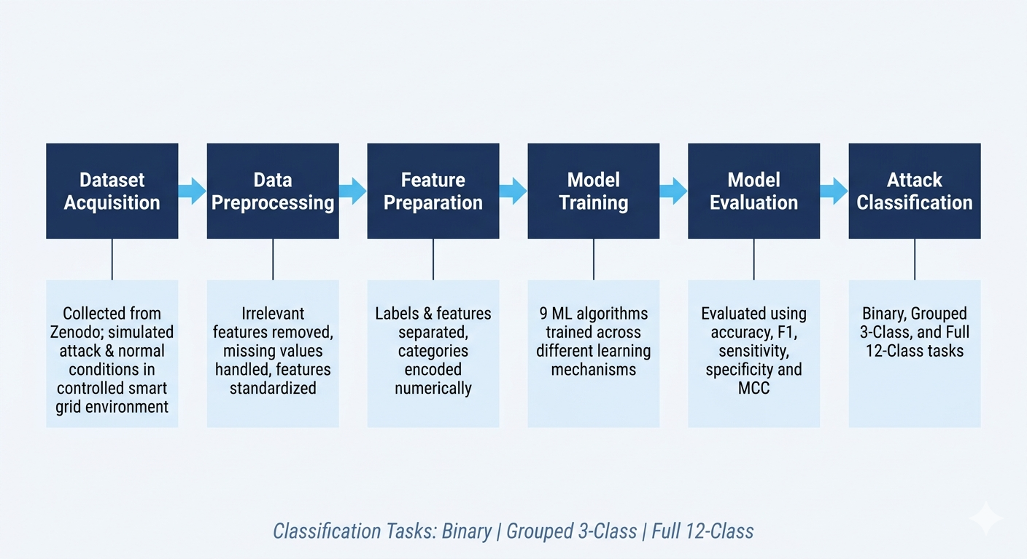
III. Proposed Approach - System Diagram
Dataset Details
Protocol: IEC 60870-5-104 (Port 2404)
Feature Extractor: IEC-104 Parser custom script decoding protocol-level payload fields
Original Columns: 112 (111 features + Label)
After Preprocessing: 90 features (21 zero-variance columns removed)
Training Rows: 5,904 (492 per class × 12 classes)
Test Rows: 2,520 (210 per class × 12 classes)
Class Balance: Perfectly balanced, same as base paper setup
Missing Values: Zero, filled with column median
Flow Timeout: 60 seconds
6

Slide 7
III. Proposed Approach
Dataset Feature Categories
Flow statistics: packet counts, byte rates, and inter-arrival times
APDU characteristics: application protocol data unit length statistics
IEC-104 message counts: I-Message, S-Message, and U-Message packets
TCP flag features: ACK and PSH flags
Protocol-specific fields: Cause of Transmission (COT) codes and Type IDs
Research Approach
A quantitative experimental approach using supervised learning was adopted, models trained on real data to learn underlying patterns of normal vs attack behavior
Three classification levels of increasing complexity were evaluated: Binary (Normal vs Malicious), Grouped 3-Class (Normal / Injection / DoS), and Full 12-Class (all 12 individual attack types)
Training models across increasing complexity levels tests how performance changes as the task becomes harder
7

Slide 8
IV. Methodology
Nine classical ML classifiers were evaluated, each with a different learning mechanism Logistic Regression: draws a linear decision boundary between classes, simple, interpretable, and computationally efficient
K-Nearest Neighbors (KNN): classifies each sample based on the majority class among its k nearest neighbors using Euclidean distance
Support Vector Machine (SVM): uses a radial basis function kernel to capture complex, nonlinear class boundaries
Decision Tree: recursively splits data using Gini impurity, produces interpretable rule-based decisions
Random Forest: builds multiple trees on random feature subsets and aggregates their votes, reduces overfitting and improves accuracy
AdaBoost: sequentially combines weak classifiers, each learning from the mistakes of the previous
Gradient Boosting: frames sequential learning as gradient descent, each iteration corrects residual errors of the previous model
Naive Bayes: probabilistic classifier using Gaussian distributions, assumes feature independence
Multi-Layer Perceptron (MLP): two hidden layers with ReLU activation, included to benchmark a neural approach against classical models
8

Slide 9
IV. Methodology
Five metrics were used, four matching the base paper for direct comparison, plus MCC for robustness
Accuracy: overall fraction of correct predictions - (TP + TN) / (TP + FP + TN + FN)
Sensitivity (Recall): attack detection rate - most critical metric for IDS since missing an attack can be catastrophic
Specificity: normal traffic recognition rate - indicates false alarm rate
F1-Score: harmonic mean of precision and recall - balances both error types
Matthews Correlation Coefficient (MCC): correlation-based metric robust to class imbalance — 0 = random, 1 = perfect
For multi-class tasks, sensitivity and F1 were computed as macro-averaged values to ensure no class is biased over others
9

Slide 10
V. Implementation Details & Results
Results - Experimental Setup & Preprocessing:
All experiments implemented in Python 3.12 on Visual Studio Code (CPU runtime) using scikit-learn 1.4, pandas, numpy, matplotlib, and seaborn
RANDOM_STATE = 42 fixed globally for all stochastic operations
Train/test split was pre-provided by dataset creators, 492 training and 210 test samples per class
Preprocessing addressed four issues: column name whitespace stripped, duplicate rows removed, infinite values replaced with NaN, missing values filled with column median (train-fit only)
SMOTE was not applied as the dataset is perfectly balanced (492 samples per class), applying it would introduce false data representation
Two-level hyperparameter tuning: optimal k for Stratified K-Fold selected per task, then RandomizedSearchCV explored 14 random combinations per model scored by F1 Macro
10

Slide 11
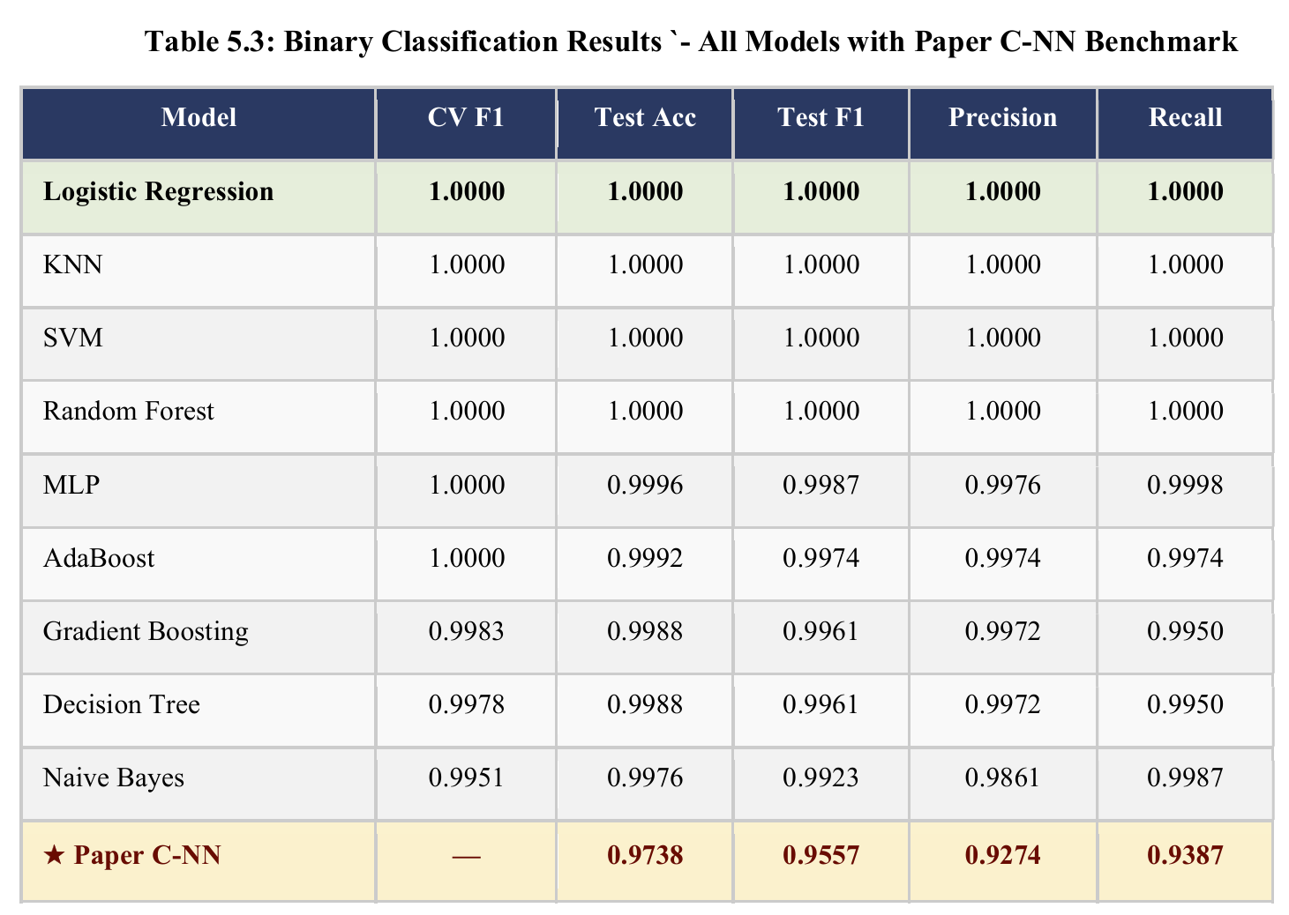
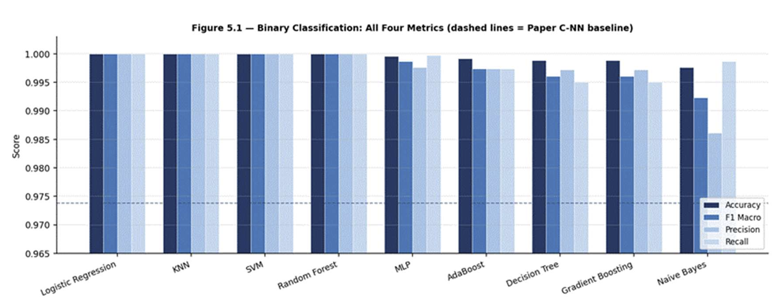
V. Implementation Details & Results
Results - Experiment 1: Binary Classification (Normal vs Attack)
All 11 attack types merged into a single ATTACK class
Best K = 3 for cross-validation
Four models — Logistic Regression, KNN, SVM, and Random Forest — achieved perfect 1.0000 across all metrics including CV F1
MLP achieved 0.9996 test accuracy
All nine classical models significantly outperformed the paper C-NN benchmark (accuracy: 0.9738, F1: 0.9557)
Near-perfect results confirm that IEC-104 parser features provide sufficient information to distinguish any attack from normal traffic at binary level
K-Fold validation independently confirms results — ruling out any data leakage concerns
11
Notes:
Which is better, to keep it seperate

Slide 12
V. Implementation Details & Results
Results - Binary Classification Results Table
Table 5.3: Binary Classification Results — All Models with Paper C-NN Benchmark
12

Slide 13
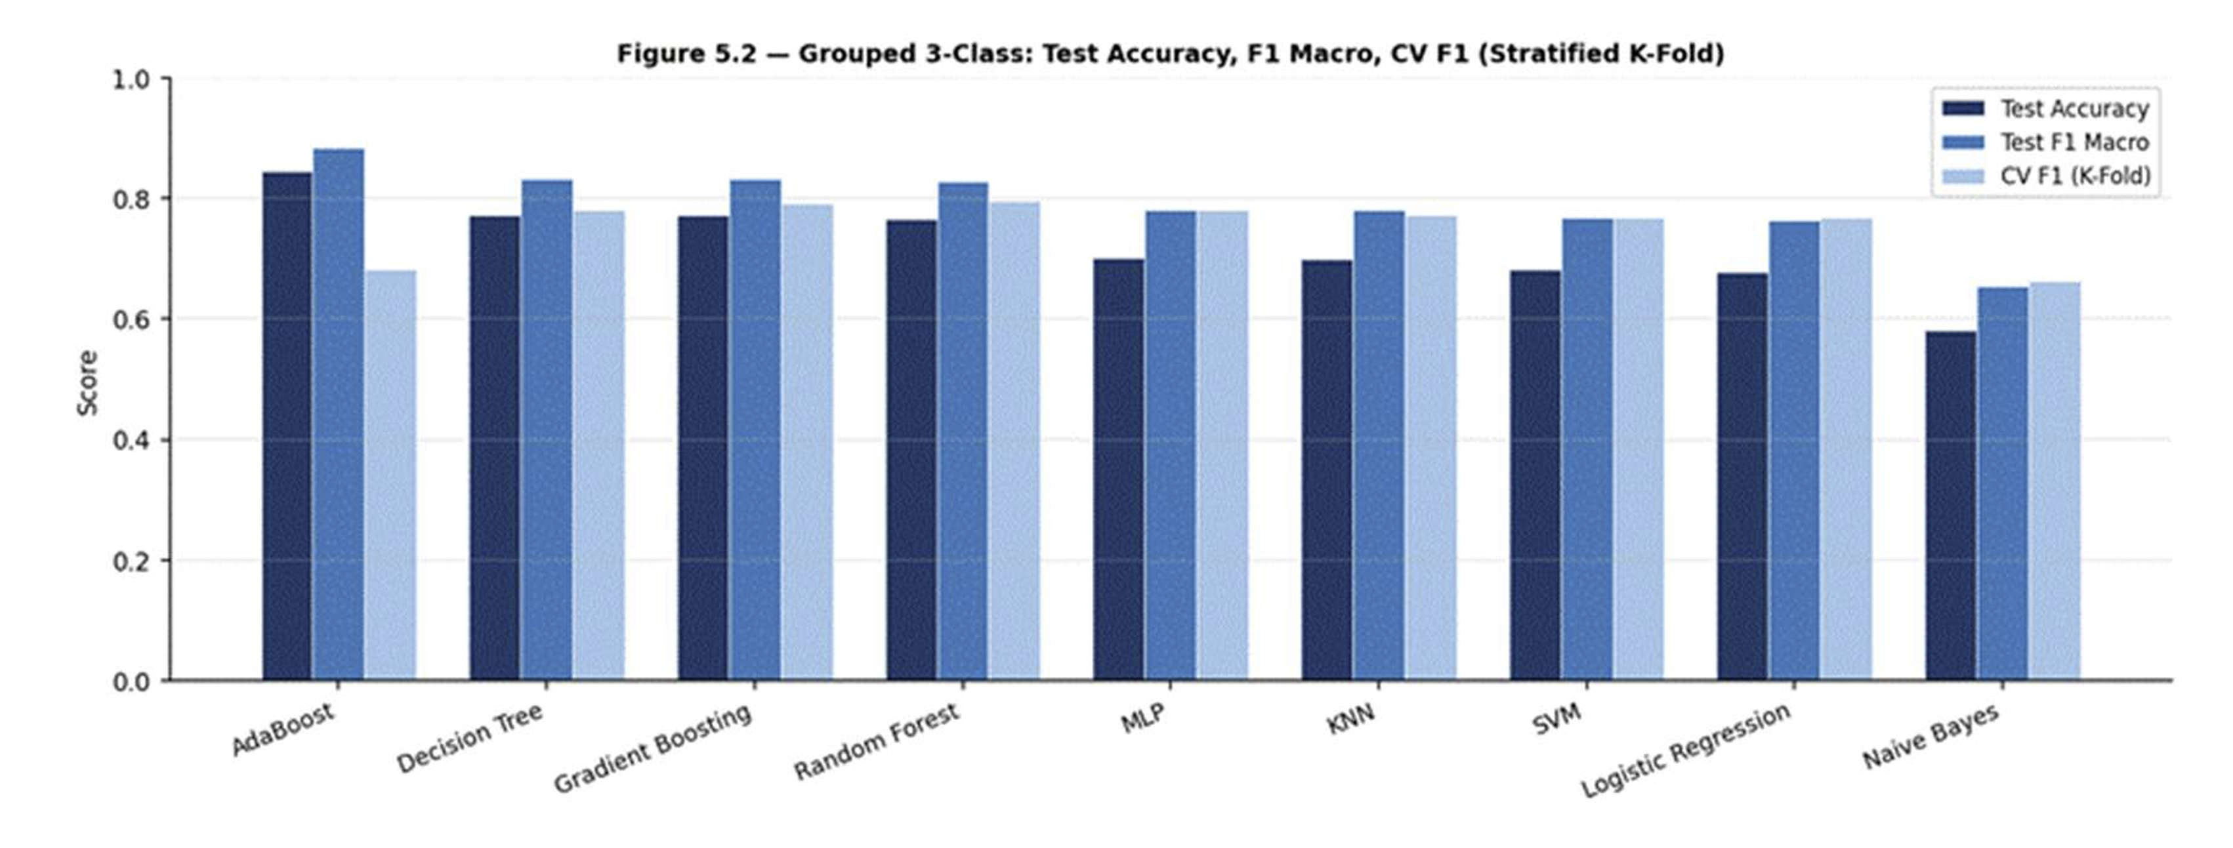
V. Implementation Details & Results
Results - Experiment 2: Grouped 3-Class Classification (Normal / DoS / Attack)
DoS attacks separated from general injection attacks
Best K = 5
AdaBoost led with highest test accuracy (0.8452) and F1 (0.8843) — but showed a severe overfit gap (CV F1 = 0.6815, gap = 0.252)
Decision Tree and Gradient Boosting followed closely at 0.7733 and 0.7725 test accuracy
Naive Bayes weakest at 0.5816 due to Gaussian independence assumption being violated by correlated IEC-104 features
Gradient Boosting identified as most reliable best-fit model for this task
Figure 5.2: Grouped 3-Class Bar Chart — Test Accuracy, F1 Macro, CV F1
13
Notes:
Which is better, to keep it seperate

Slide 14
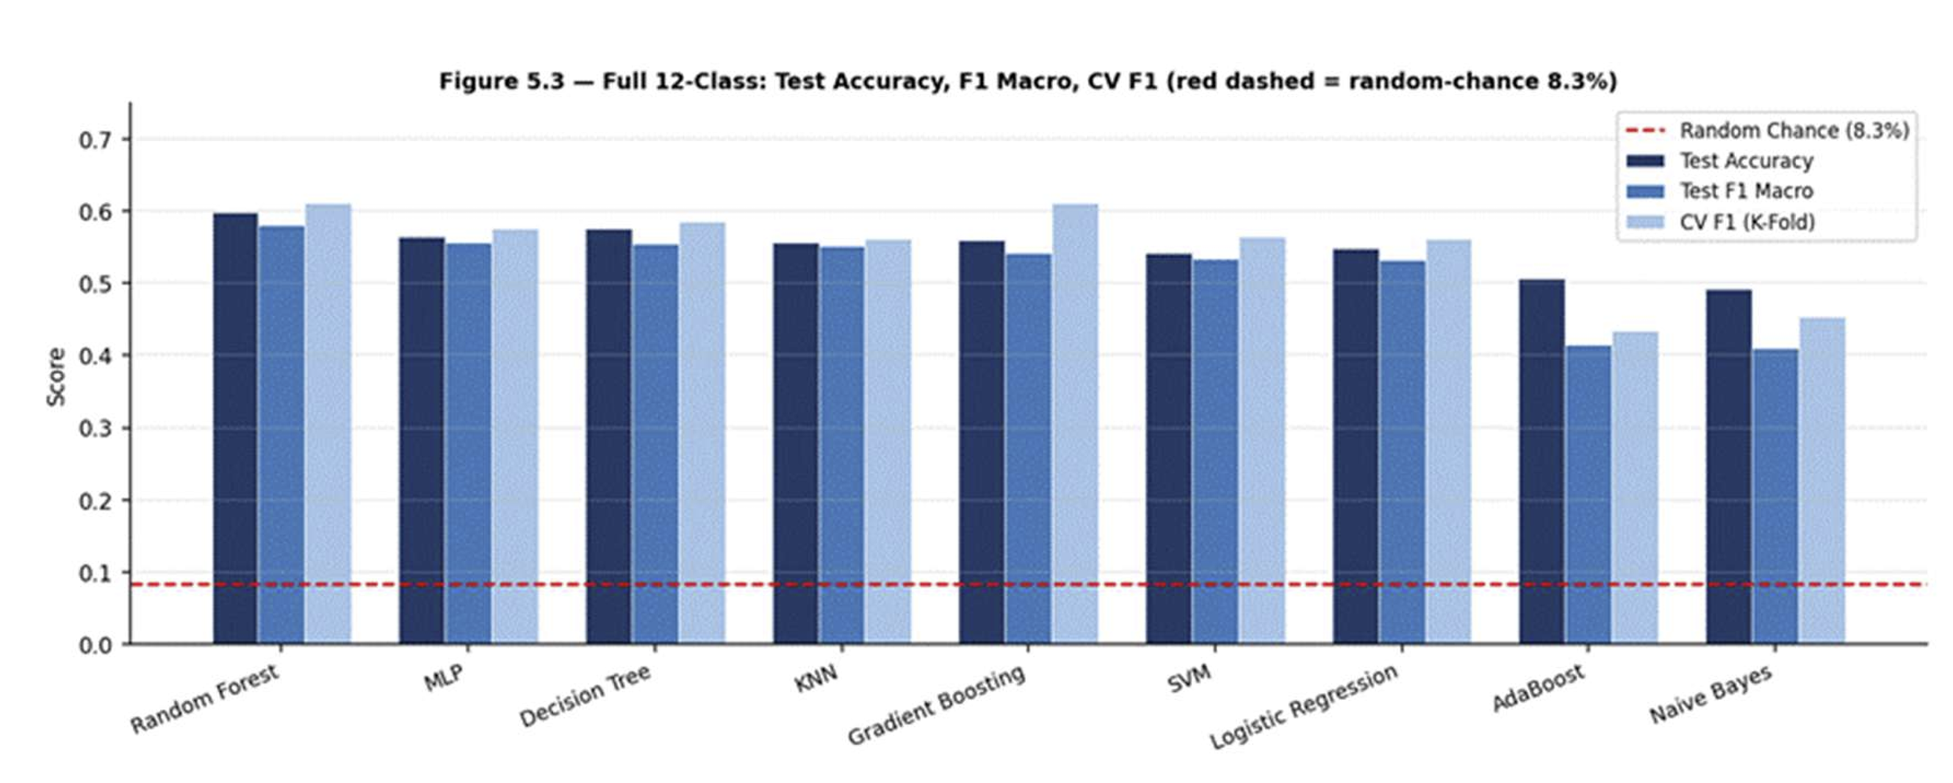
V. Implementation Details & Results
Results - Experiment 3: Full 12-Class Classification
All 12 original attack labels retained
Best K = 3
Random-chance baseline = 1/12 = 8.33%
All nine models significantly exceeded the random-chance baseline, confirming genuine learning
Random Forest led with 0.5987 test accuracy and CV F1 of 0.6109
Gradient Boosting achieved highest CV F1 of 0.6124 indicating better generalisation potential
AdaBoost showed underfitting (test accuracy 0.5066, CV F1 0.4347) — boosting mechanism collapses under 12 overlapping class boundaries
Naive Bayes weakest overall at 0.4923 test accuracy
Figure 5.3: Full 12-Class Bar Chart — Test Accuracy, F1 Macro, CV F1 with 8.33% Random-Chance Baseline
14
Notes:
Which is better, to keep it seperate

Slide 15
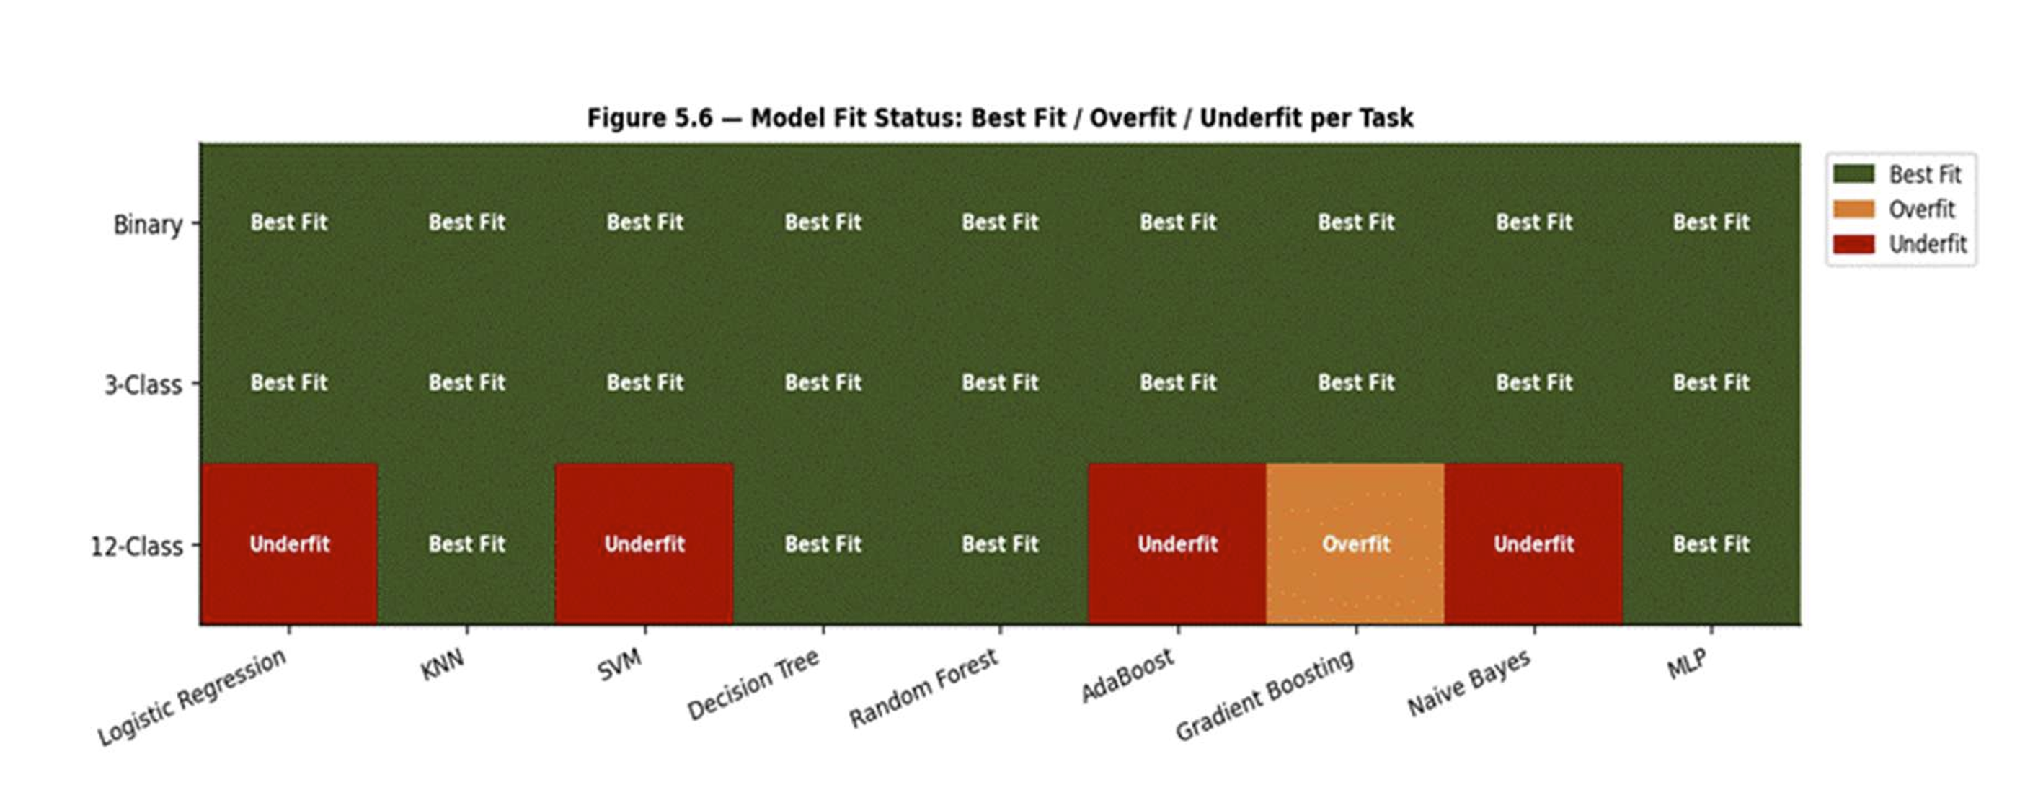
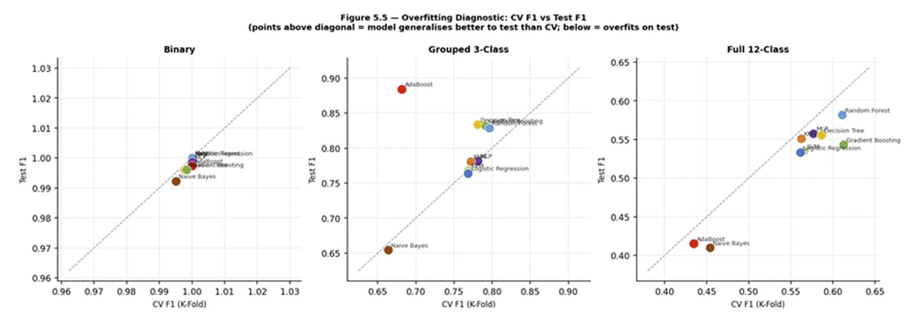
V. Implementation Details & Results
Results - Model Fit Analysis
Model fit diagnosed by comparing CV F1 Macro against Test F1 Macro across three conditions
Best Fit: gap < 0.05 AND test accuracy ≥ 0.70 — model generalises well
Overfit: CV F1 much lower than Test F1 (gap > 0.05) — model memorised training patterns
Underfit: test accuracy < 0.60 AND CV F1 < 0.55 — features insufficient to learn meaningful boundaries
Binary: all nine models are Best Fit — CV F1 equals Test F1 for top four models confirming no data leakage
3-Class: AdaBoost is the sole Overfit case (gap = 0.252) — all others Best Fit
12-Class: AdaBoost and Naive Bayes show Underfit behaviour
[ PLACEHOLDER — Figure 5.5: Overfitting Diagnostic Scatter Plot — CV F1 vs Test F1 ]
[ PLACEHOLDER — Figure 5.6: Model Fit Status Heatmap — Best Fit / Overfit / Underfit per Task ]
15
Notes:
Which is better, to keep it seperate

Slide 16
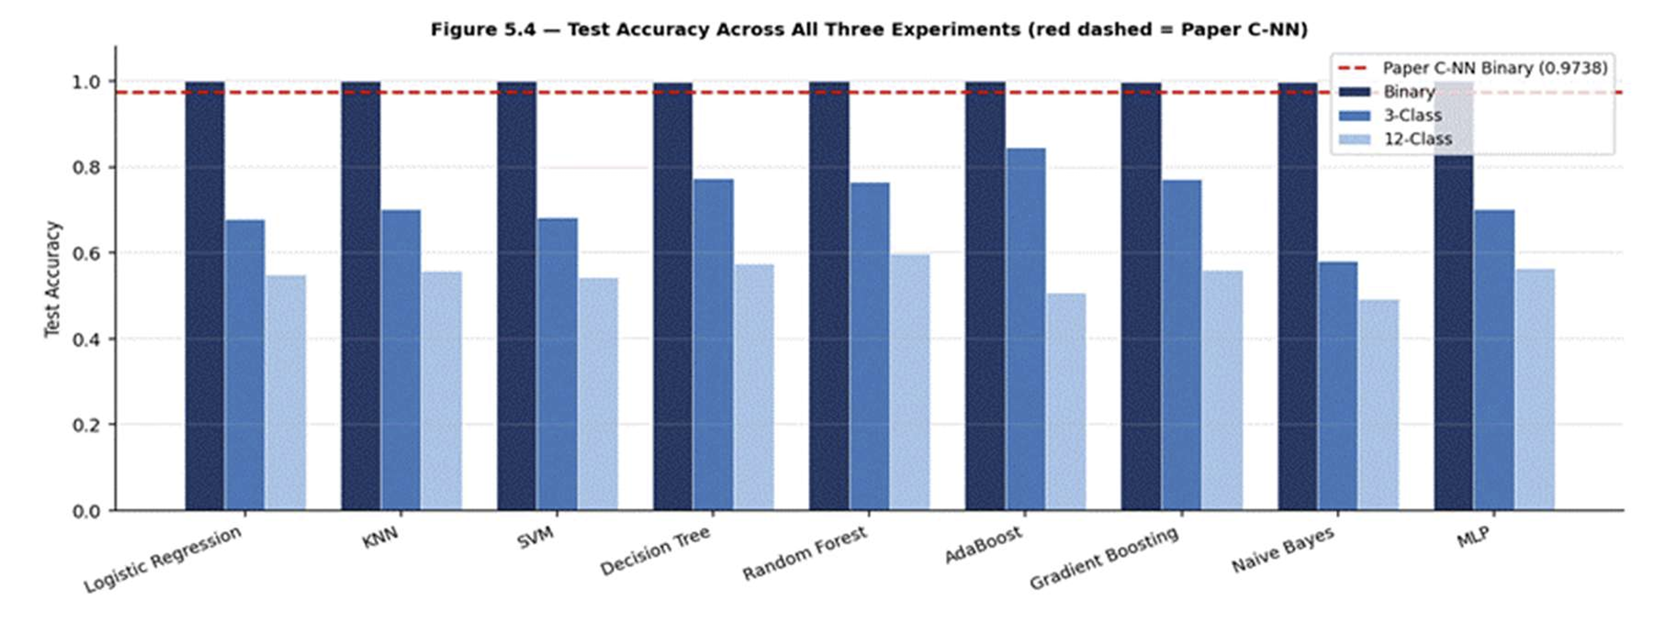
V. Implementation Details & Results
Results - Cross-Experiment Comparison
Binary: LR / KNN / SVM / RF tied at perfect F1 of 1.0000 — all 9 models beat C-NN benchmark
3-Class: AdaBoost best at F1 0.8843, Naive Bayes worst at 0.6545
12-Class: Random Forest best at F1 0.5818, Naive Bayes worst at 0.4099
Clear performance degradation pattern observed: ~100% (Binary) → ~77–88% (3-Class) → ~50–60% (12-Class)
This degradation reflects the ceiling imposed by flow-level features — individual command types cannot be distinguished without packet payload fields like TypeID and IOA
16
Notes:
Which is better, to keep it seperate

Slide 17
VI. Result Discussion
Binary Classification (Normal vs. Attack)
Perfect Scores: Logistic Regression, KNN, SVM, and Random Forest achieved perfect accuracy and F1-scores (1.0000).
Outperformance: All nine classical models surpassed the benchmark C-NN model (0.9738 accuracy).
Insight: IEC-104 parser features are highly effective for simply distinguishing malicious traffic from normal traffic.
Grouped 3-Class Classification (Normal / DoS / Injection)
Top Performer (with caution): AdaBoost achieved the highest test accuracy (0.8452) but showed severe overfitting (large gap between CV and Test F1).
Most Reliable Model: Gradient Boosting was identified as the best-fit model, balancing accuracy and generalization.
Weakest Performer: Naive Bayes struggled due to its assumption of feature independence, which is violated by correlated network data.

Slide 18
VI. Result Discussion
Full 12-Class Classification
Overall Challenge: All models found this task significantly more difficult, with performance dropping to the 50-60% range.
Top Performer: Random Forest led with 0.5987 test accuracy, showing the strength of ensemble methods for complex tasks.
Model Failures: AdaBoost and Naive Bayes showed signs of underfitting, unable to learn the complex boundaries between 12 distinct attack types.
Baseline: All models performed well above the random-chance baseline of 8.33%, confirming genuine learning.
Performance Degradation Trend
A clear performance ceiling was observed: ~100% (Binary) → ~77–88% (3-Class) → ~50–60% (12-Class).
Implication: Flow-level statistics alone are insufficient for fine-grained, multi-class attack identification. Distinguishing specific command types likely requires deep packet inspection (e.g., TypeID, IOA fields).

Slide 19
VII. Conclusion
Summary of Main Findings
Classical ML models are highly effective for binary FDI detection, even outperforming a more complex C-NN benchmark.
For multi-class identification, ensemble tree-based methods (Random Forest, Gradient Boosting) are the most robust and reliable.
The complexity of the task significantly impacts performance; distinguishing 12 attack types is a much harder problem than simple anomaly detection.
Key Contributions
This study provides a comprehensive benchmark of nine classical ML models against a state-of-the-art C-NN on the same IEC-104 dataset.
It quantifies the performance gap between binary, grouped, and fine-grained multi-class classification tasks.
It highlights that for operational deployment, the choice of model should depend on the required granularity of detection (simple alert vs. specific attack labeling).

Slide 20
VII. Future Scope and Applications
Improvements to Current Work
1. Incorporate Payload Features: Extend feature extraction to include deep packet inspection fields like TypeID and IOA to improve multi-class accuracy.
2. Advanced Feature Engineering: Explore automated feature engineering or selection techniques to reduce noise and improve model generalization.
Extensions and Future Research Directions
1. Real-Time Detection: Implement and test the best-performing models (e.g., Random Forest) in a real-time streaming context (e.g., with Apache Kafka or similar).
2. Explainable AI (XAI): Use SHAP or LIME to interpret the decisions of tree-based models, addressing the "black box" concern for industrial deployment.
3. Generative & Deep Learning: Investigate hybrid models that combine the efficiency of classical methods with the pattern recognition power of deep learning for complex attacks.

Slide 21
VII. Future Scope and Applications
SDG 7 – Affordable and Clean Energy - Enhances reliable and efficient smart grid energy distribution through AI-based optimization.
SDG 9 – Industry, Innovation and Infrastructure - Strengthens resilient digital infrastructure using AI-driven cybersecurity for smart grids.
SDG 11 – Sustainable Cities and Communities - Supports secure and reliable power systems for smart city infrastructure.
SDG 12 – Responsible Consumption and Production - Promotes efficient energy utilization by optimizing power flow and reducing system losses.
SDG 16 – Peace, Justice and Strong Institutions - Enhances the security and resilience of critical national infrastructure by detecting and mitigating cyber attacks in smart grid systems.

Slide 22
References
Zheng Y., Liu X., and Wang H. — "Detection to False Data for Smart Grid," Cybersecurity, vol. 8, no. 1, 2025. DOI: 10.1186/s42400-024-00326-5
Zhang Y., Wang J., and Chen B. — "Detecting False Data Injection Attacks in Smart Grids: A Semi-Supervised Deep Learning Approach," IEEE Transactions on Smart Grid, vol. 12, no. 1, pp. 623–634, Jan. 2021
Zhong X., Li G., and Zhang C. — "False data injection in power smart grid and identification of the most vulnerable bus; a case study 14 IEEE bus network," Energy Reports, vol. 7, pp. 8476–8484, Nov. 2021
Mukherjee D., Chakraborty S., and Ghosh S. — "Deep learning-based multilabel classification for locational detection of false data injection attack in smart grids," Electrical Engineering, vol. 104, no. 1, pp. 259–282, May 2021
Wang Y. et al. — "Wide and Recurrent Neural Networks for Detection of False Data Injection in Smart Grids," Wireless Algorithms, Systems, and Applications, pp. 335–345, 2019
He Z. et al. — "Detection of false data injection attacks leading to line congestions using Neural networks," Sustainable Cities and Society, vol. 82, p. 103861, Jul. 2022
Hu P. et al. — "Detection of False Data Injection Attacks in Smart Grids Based on Expectation Maximization," Sensors, vol. 23, no. 3, p. 1683, Feb. 2023
Pan H. et al. — "Multi-data classification detection in smart grid under false data injection attack based on Inception network," IET Renewable Power Generation, vol. 18, no. 14, pp. 2430–2439, Aug. 2024
Boyaci O. et al. — "Joint Detection and Localization of Stealth False Data Injection Attacks in Smart Grids Using Graph Neural Networks," IEEE Transactions on Smart Grid, vol. 13, no. 1, pp. 807–819, Jan. 2022
Haghshenas S.H. et al. — "A Temporal Graph Neural Network for Cyber Attack Detection and Localization in Smart Grids," IEEE ISGT Conference, pp. 1–5, Jan. 2023
Yin X. et al. — "PowerFDNet: Deep Learning-Based Stealthy False Data Injection Attack Detection for AC-Model Transmission Systems," IEEE Open Journal of the Computer Society, vol. 3, pp. 149–161, 2022
Tian J. et al. — "LESSON: Multi-Label Adversarial False Data Injection Attack for Deep Learning Locational Detection," IEEE Transactions on Dependable and Secure Computing, vol. 21, no. 5, pp. 4418–4432, Sep. 2024
22

Slide 23
References
Shrestha R. et al. — "Detection and Localization of the FDI Attacks in the Presence of DoS Attacks in Smart Grid," Smart Cities, vol. 8, no. 5, p. 144, Sep. 2025
Liu Z. et al. — "False Data Injection Attacks on Data-Driven Algorithms in Smart Grids Utilizing Distributed Power Supplies," Engineering, vol. 51, pp. 62–74, Aug. 2025
Ahmad H. et al. — "AI-based approach for detecting FDI attacks in load frequency control for centralized multi-area power systems," Computers and Electrical Engineering, vol. 123, p. 110060, Apr. 2025
23

Slide 24
THANK YOU
24

